Slide 1
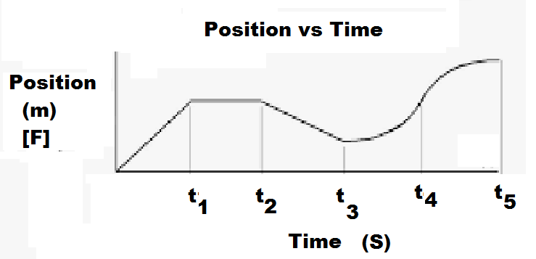
Graphing Minds-On!!

Slide 2
